Slide 1

CNT Tutorial 1
Nachiket kulkarni

Slide 2
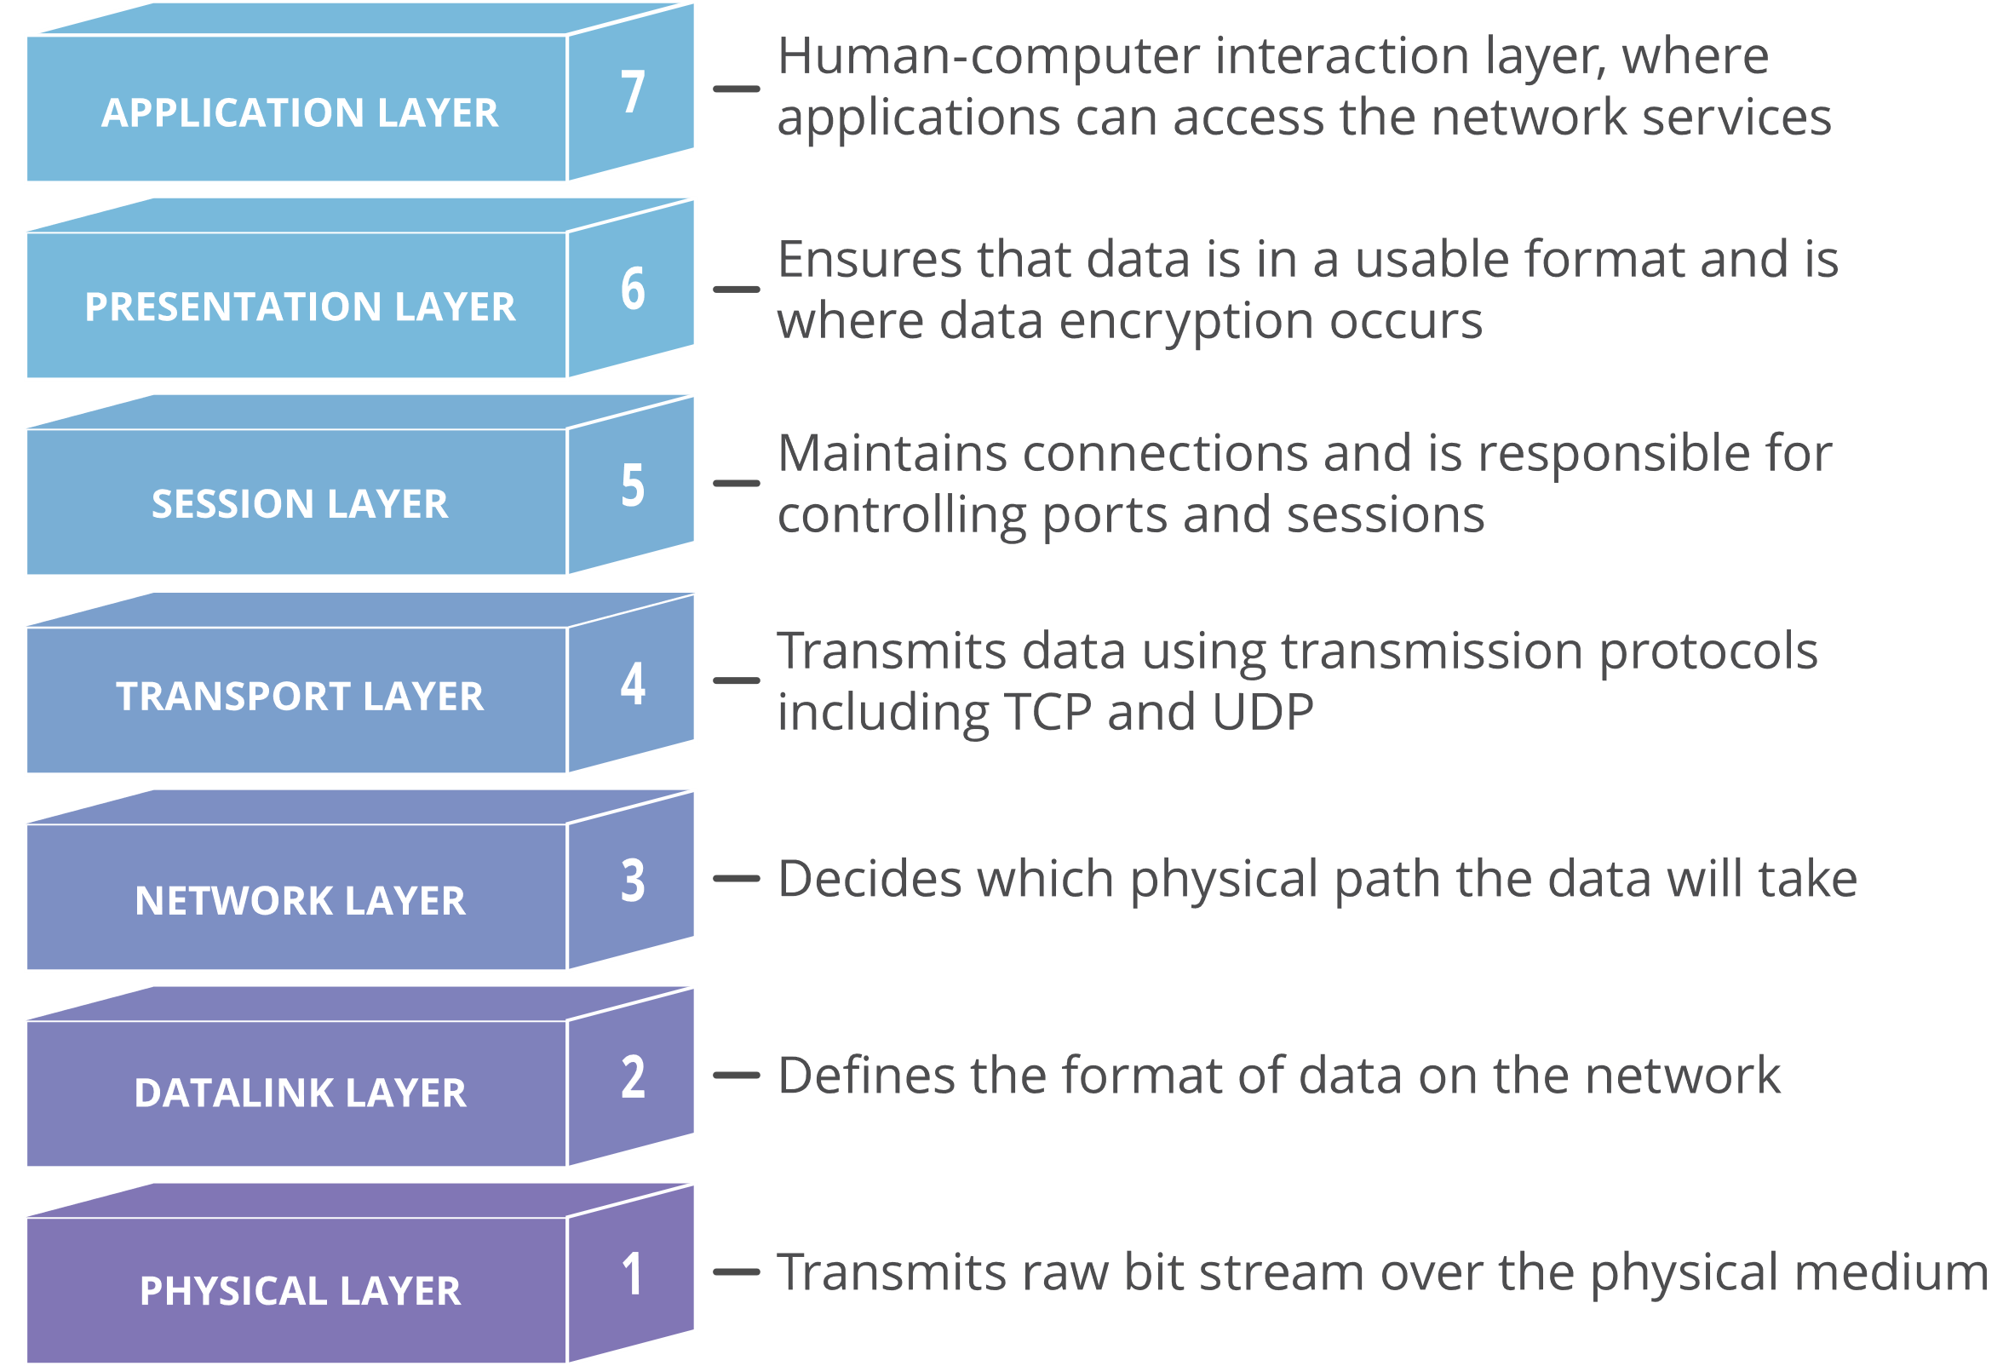
OSI Model Layers

Slide 3
OSI Model Layers
Mr. X wants to send an email to Mr. Y
Email message is sent to application layer
It will pick a protocol (SMTP: Simple Mail Transfer Protocol) and pass the data along to the presentation layer
The presentation layer will then compress the data and then it will hit the session layer
Session Layer will initialize the communication session
Data will go to transport layer where it will be segmented.
In Network layer, the segments will be broken into packets
In Data Link Layer, the packets will be broken into frames
Physical Layer will convert the frames to bit stream of 1s and 0s and then send it over medium such as cable

Slide 4
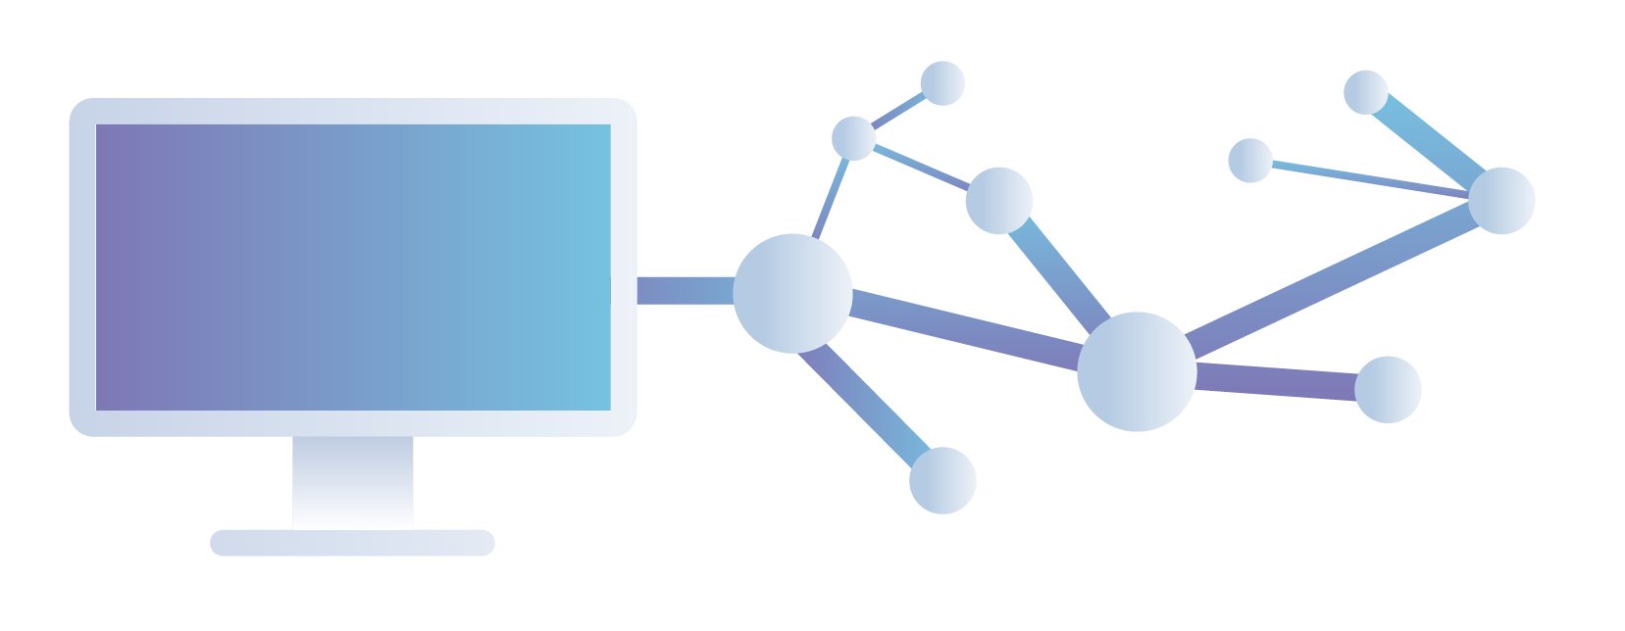
Network Layer

Slide 5
Network Layer
Responsible for the source-to-destination delivery of a packet, possibly across multiple networks
The network layer ensures that each packet gets from its point of origin to its final destination
Adds header that includes logical address (IP Address) of sender and receiver
It also provides routing mechanism

Slide 6
Working with IP Addresses
When two devices on a network want to communicate, they need logical addresses.
Most modern networks use Internet Protocol (IP) addressing, as opposed to other Layer 3 addressing.
Two versions of IP addressed
We will discuss how IP concepts are applied to IP version 4 (IPv4).

Slide 7
IPv4 Addressing
Although IPv6 is increasingly being adopted in corporate networks, IPv4 is by far the most popular Layer 3 addressing scheme in today’s networks.
Devices on an Ipv4 network use unique IP addresses to communicate with one another.
An IPv4 address is a 32-bit address. That is typically written in dotted-decimal notation. Such as 10.1.2.3

Slide 8
IPv4 Addressing
Address Space
An address space is the total number of addresses used by the protocol
If a protocol uses N bits to define an address, the address space is 2^{N}
IPv4 uses 32-bit addresses, which means that the address space is 2³² or 4,294,967,296 (more than 4 billion)
That means, theoretically, if there were no restrictions, more than 4 billion devices could be connected to the Internet

Slide 9
IPv4 Addressing
Notice that the IP address is divided into four separate numbers, separated by periods.
Each of these four divisions represents 8 bits, and are called octets.
IP addressing
Unique IP address per host
Unique address per logical network
Communicate between LANs without broadcasts

Slide 10
IPv4 Address Structure
Notations: Binary and Dotted Decimal
Binary
Example: 11000000101010000000010000000010
Broken into four groups of eight 11000000.10101000.00000100.00000010
Dotted Decimal
Each 8-bit value converted into a decimal number between 0 and 255, example: 192.168.4.2

Slide 11
IPv4 Address Structure
Change the following IPv4 addresses from binary notation to dotted-decimal notation
10000001 00001011 00001011 11101111
11000001 10000011 00011011 11111111

Slide 12
IPv4 Address Structure
Change the following IPv4 addresses from binary notation to dotted-decimal notation
10000001 00001011 00001011 11101111
11000001 10000011 00011011 11111111
We replace each group of 8 bits with its equivalent decimal number (see Appendix B) and add dots for separation
129.11.11.239
193.131.27.255

Slide 13
IPv4 Address Structure
Change the following IPv4 addresses from dotted-decimal notation to binary notation
111.56.45.78
221.34.7.82

Slide 14
IPv4 Address Structure
Change the following IPv4 addresses from dotted-decimal notation to binary notation
111.56.45.78
221.34.7.82
We replace each decimal number with its binary equivalent
01101111 00111000 00101101 01001110
11011101 00100010 00000111 01010010

Slide 15
IPv4 Address Structure
Find the error, if any, in the following IPv4 addresses
111.56.045.78
221.34.7.8.20
75.45.301.14
11100010.23.14.67
There must be no leading zero (045).
There can be no more than four numbers in an IPv4 address.
Each number needs to be less than or equal to 255 (301 is outside this range).
A mixture of binary notation and dotted-decimal notation is not allowed.

Slide 16
IPv4 Address Structure
IP must do three things
Give each LAN its own identifier
Allow routers connecting LANs to use network identifiers to send packets to the right network
Give each computer a way to understand when a packet is intended for a computer on the local LAN or for a computer on the WAN

Slide 17
IPv4 Address Structure
Network prefix and Host number
The network prefix identifies a network and the host number identifies a specific host (actually, interface on the network).
network prefix
host number
32 bits

Slide 18
IPv4 Address Structure: Classful IP Addresses
When Internet addresses were standardized (early 1980s), the Internet address space was divided up into classes:
Class A: Network prefix is 8 bits long
Class B: Network prefix is 16 bits long
Class C: Network prefix is 24 bits long
Each IP address contained a key which identifies the class:
Class A: IP address starts with “0”
Class B: IP address starts with “10”
Class C: IP address starts with “110”

Slide 19
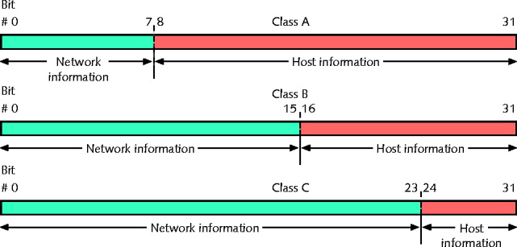
IPv4 Address Structure
IP must give each LAN its own identifier
Network IDs
All computers on same LAN must have same network ID
Each computer on same LAN must have a unique host ID

Slide 20
IPv4 Address Structure

Slide 21
IPv4 Address Structure
We will learn about multicast addresses later in this course.

Slide 22
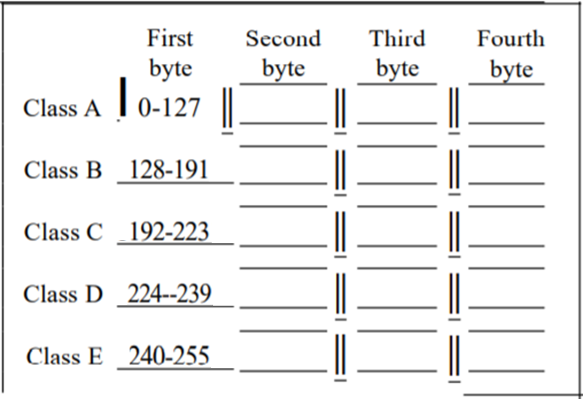
IPv4 Address Structure
Much easier with dotted decimal notation

Slide 23
IPv4 Address Structure
Find the class of each address.
00000001 00001011 00001011 11101111
11000001 10000011 00011011 11111111
14.23.120.8
252.5.15.111
The first bit is O. This is a class A address.
The first 2 bits are 1; the third bit is O. This is a class C address.
The first byte is 14 (between 0 and 127); the class is A
The first byte is 252 (between 240 and 255); the class is E

Slide 24
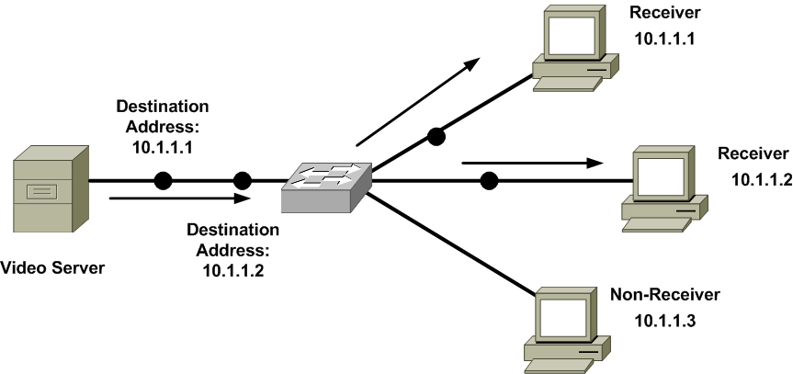
Types of Addresses
Unicast
meaning that traffic travels from a single source device, to a single destination device.

Slide 25
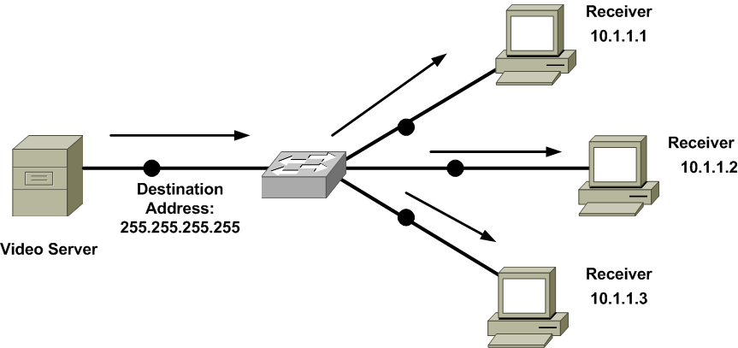
Types of Addresses
Broadcast
meaning that traffic travels from a single source device, to all destination device.

Slide 26
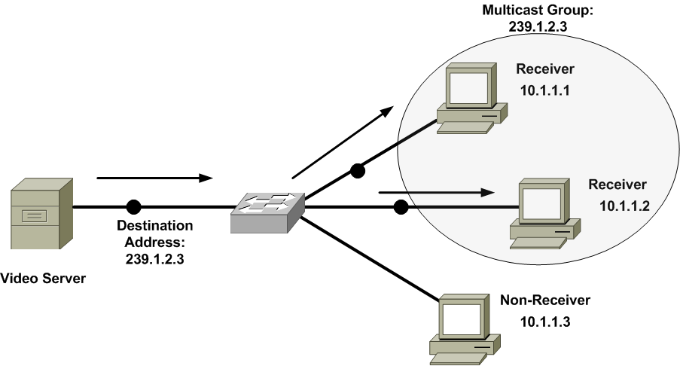
Types of Addresses
Multicast
meaning that traffic travels from a single source device, to multiple, yet specific, destination devices.

Slide 27
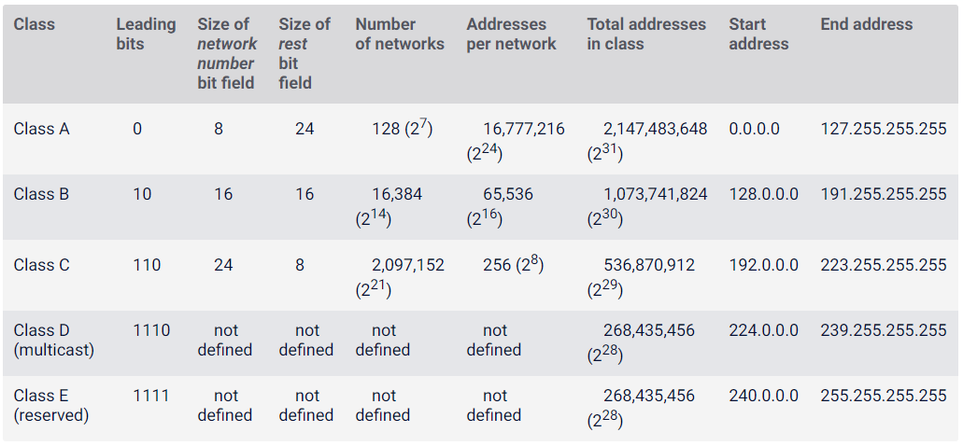
IPv4 Address Structure

Slide 28
IPv4 Address Structure
Default mask is used to identify the network address
For class A, default mask is: 255.0.0.0
AND the default mask and the IP address to get the network address
In a mask:
1: corresponding IPv4 address bits contain network information
0: corresponding IPv4 address bits contain host information

Slide 29
IPv4 Address Structure
Example Class A network address: 114.56.20.33, 255.0.0.0
Network information = 114.
Host information = 56.204.33
Example Class B network address: 147.12.38.81, 255.255.0.0
Network information = 147.12.
Host information = 38.81
Example Class C network address: 214.51.42.7, 255.255.255.0
Network information = 214.57.42.
Host information = 7

Slide 30
IPv4 Address Classes
Address Class | Value in First Octet | Classful Mask (Dotted Decimal) | Classful Mask (Prefix Notation)
Class A | 1 -126 | 255.0.0.0 | /8
Class B | 128 -191 | 255.255.0.0 | /16
Class C | 192 - 223 | 255.255.255.0 | /24
Class D | 224 – 239 | N/A | N/A
Class E | 240 – 255 | N/A | N/A

Slide 31
IPv4 Address Structure
Are the following two IP addresses on the same network?
142.127.55.4
142.56.55.7
70.66.122.143
70.120.43.56
192.168.2.1
192.168.5.8

